Slide 1
Loan Prediction Analysis
My Try

Slide 2
OBJECTIVE
We are provided with loan prediction datasets. – train & test
Banks want to decide whether they can provide loan to a person based on their data
Our goals are as follows
Analyse the train dataset and identify factors affecting our target variable
Fit a logistic regression model for train dataset and test it with test dataset
Predict which person can be trusted to provide a loan.
Plot the ROC curve
The jupyter notebook containing the code can be found in the repository

Slide 3
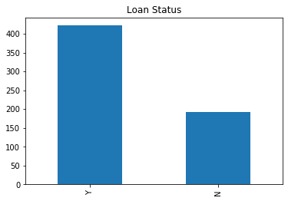
Loan prediction analysis
Firstly, we will see how many people were provided loan in the train dataset
it is seen that 68.7% of the people
were provided with loans

Slide 4
UNIVARIATE ANALYSIS
DIFFERENT TYPES OF features IN THIS Dataset:
Categorical features: These features have categories (Gender, Married, Self_Employed, Credit_History, Loan_Status)
Ordinal features: Variables in categorical features having some order involved (Dependents, Education, Property_Area)
Numerical features: These features have numerical values (Applicant Income, Co-applicant Income, Loan Amount, Loan Amount Term)

Slide 5
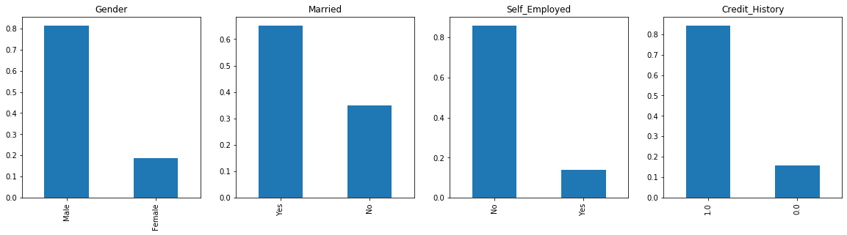
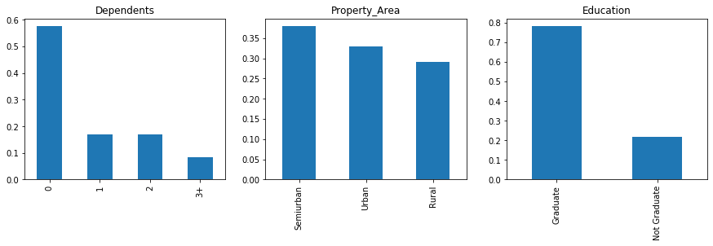
Categorical and ordinal features

Slide 6
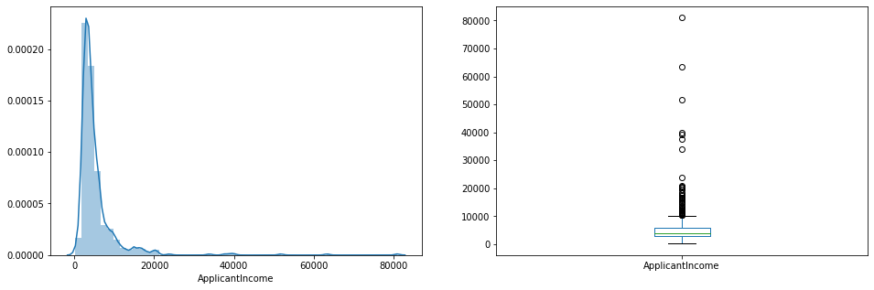
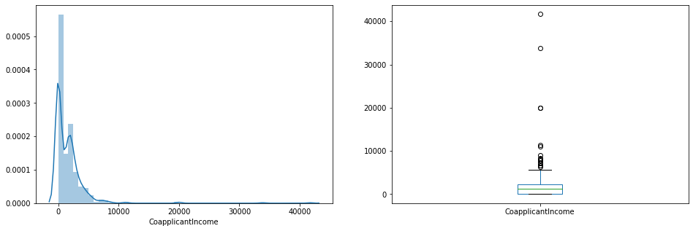
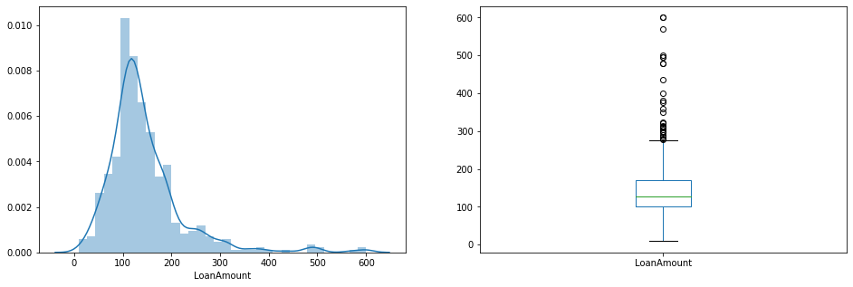
numerical features

Slide 7
Conclusions from univariate analysis
Categorical:
80% applicants in the dataset are male.
Around 65% of the applicants in the dataset are married.
Around 15% applicants in the dataset are self employed.
Around 85% applicants have repaid their debts.
Ordinal:
Most of the applicants don’t have any dependents.
Around 80% of the applicants are Graduate.
Most of the applicants are from Semi-urban area.
Numerical:
All the 3 variables have a lot of outliers – should be treated later

Slide 8
Data cleaning and filling missing values
It is seen that variables like Gender, Married, Dependents, Self_Employed, Loan Amount, Loan_Amount_Term and Credit_History have missing values.
Based on analysis, loan amount’s null values are filled with the median whereas other variables’ null values are filled with the mode values
Missing values should be filled in both train and test dataset

Slide 9
Outlier treatment
While analysing numerical variables, it is seen that all of them have a lot of outliers. This affects our analysis and model fitting. Hence it is necessary to make the right-skewed distribution to a normal distribution
So we try log transformation, that way, small values remain small and larger values become small.
And we get a normal distribution of variables after doing log transformation

Slide 10
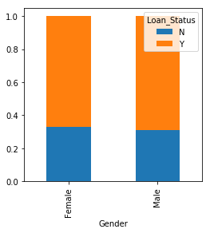
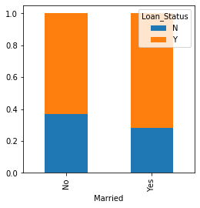
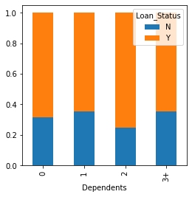
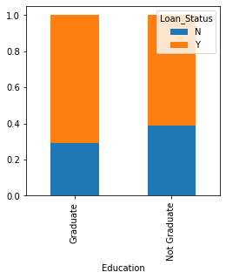
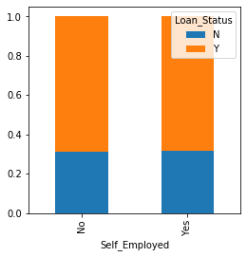
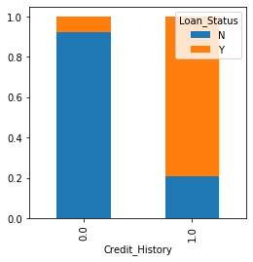
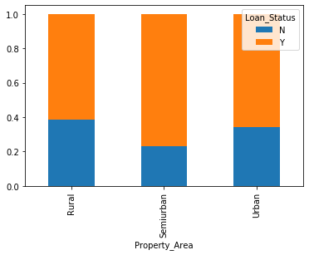
Bivariate analysis – all vs loan_status

Slide 11
Conclusions from bivariate analysis
the proportion of male and female applicants is more or less same for both approved and unapproved loans.
Proportion of married applicants is higher for the approved loans.
Distribution of applicants with 1 or 3+ dependents is similar across both the categories of Loan_Status.
There is nothing significant we can infer from Self_Employed vs Loan_Status plot.
It seems people with credit history as 1 are more likely to get their loans approved.
Proportion of loans getting approved in semi-urban area is higher as compared to that in rural or urban areas.

Slide 12
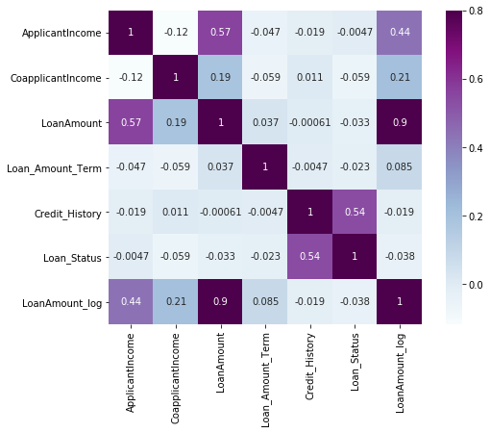
Correlation matrix
From the correlation matrix, it is seen that Credit_History has a very good correlation value with that of the target variable - loan_status
We can also see that there is a high correlation value between Loan amount – applicant income and Loan amount – co-applicant income

Slide 13
Applying logistic regression
From the previous analyses, we chose to fit the train dataset (except target variable) with the target variable by logistic regression
After, logistic regression was applied, The model was checked with the test dataset
The model had an accuracy score of 81 %
Predicted values were put in a separate column in the test dataset
ROC curve has been plotted
Other algorithms like Random Forest can be fitted for higher accuracy

Slide 14
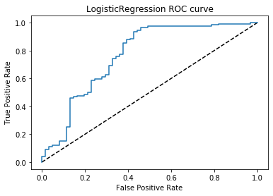
Roc curve
Logistic Regression AUC – 0.767

